Slide 1
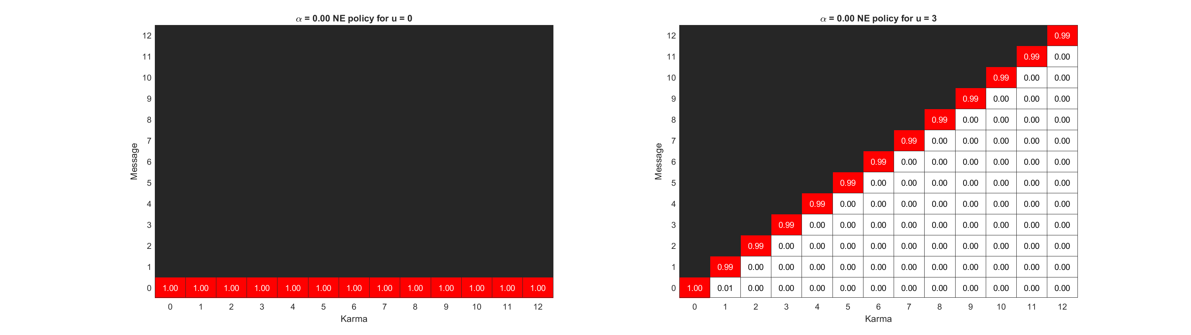
Notes:
Top: k_ave = 3, k_max = 12
Bottom: k_ave = 6, k_max = 12

Slide 2
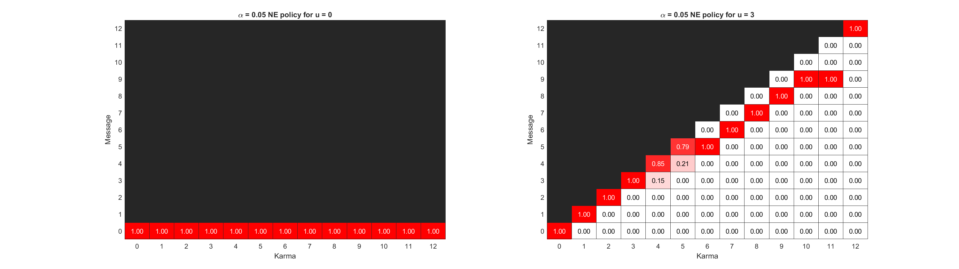

Notes:
Top: k_ave = 3, k_max = 12
Bottom: k_ave = 6, k_max = 12

Slide 3

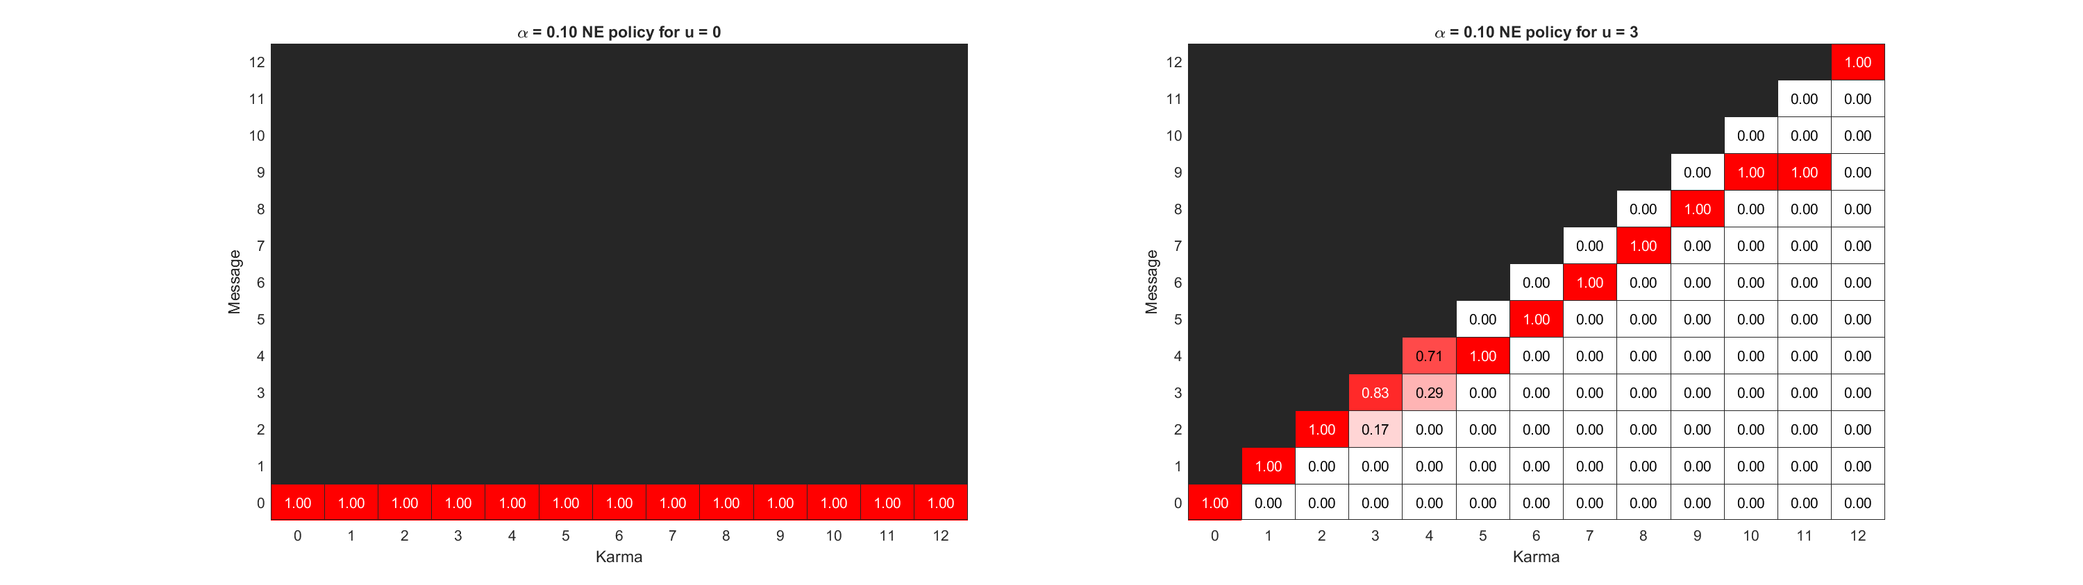
Notes:
Top: k_ave = 3, k_max = 12
Bottom: k_ave = 6, k_max = 12

Slide 4
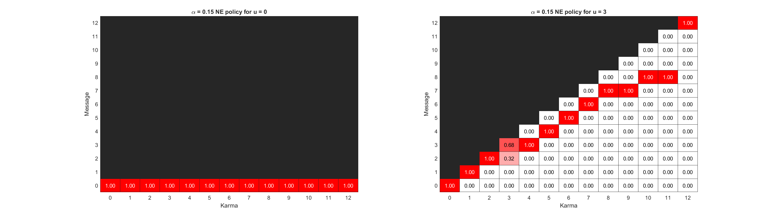
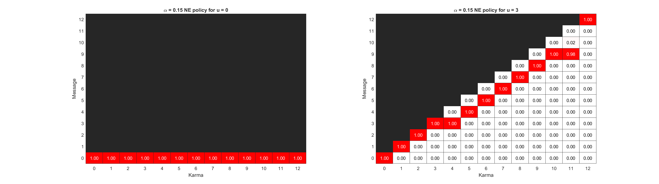
Notes:
Top: k_ave = 3, k_max = 12
Bottom: k_ave = 6, k_max = 12

Slide 5
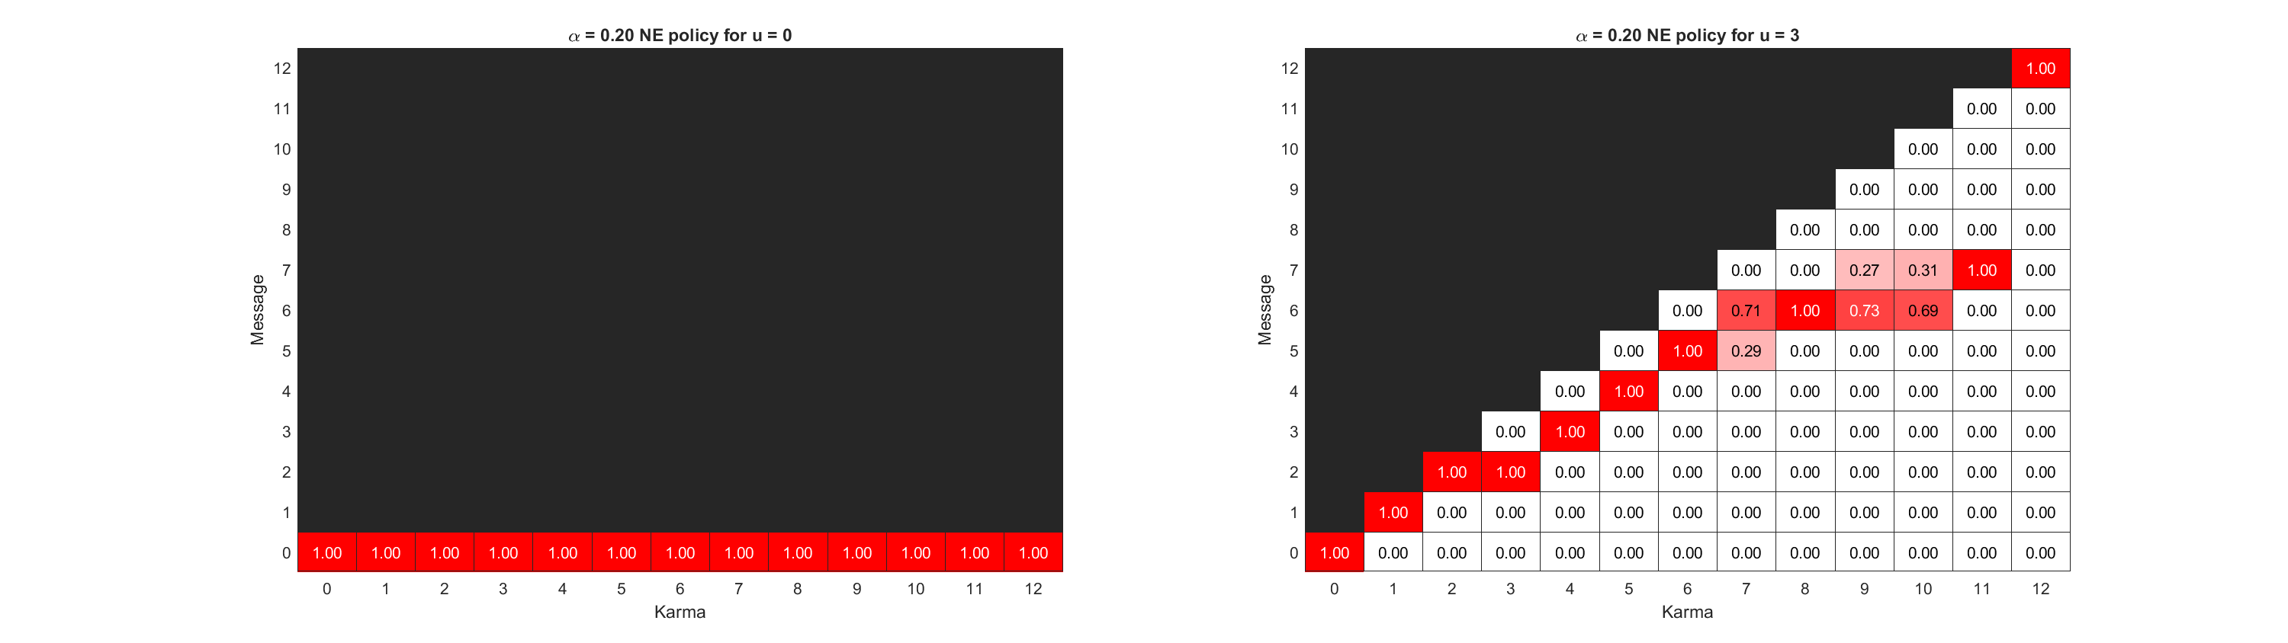

Notes:
Top: k_ave = 3, k_max = 12
Bottom: k_ave = 6, k_max = 12

Slide 6
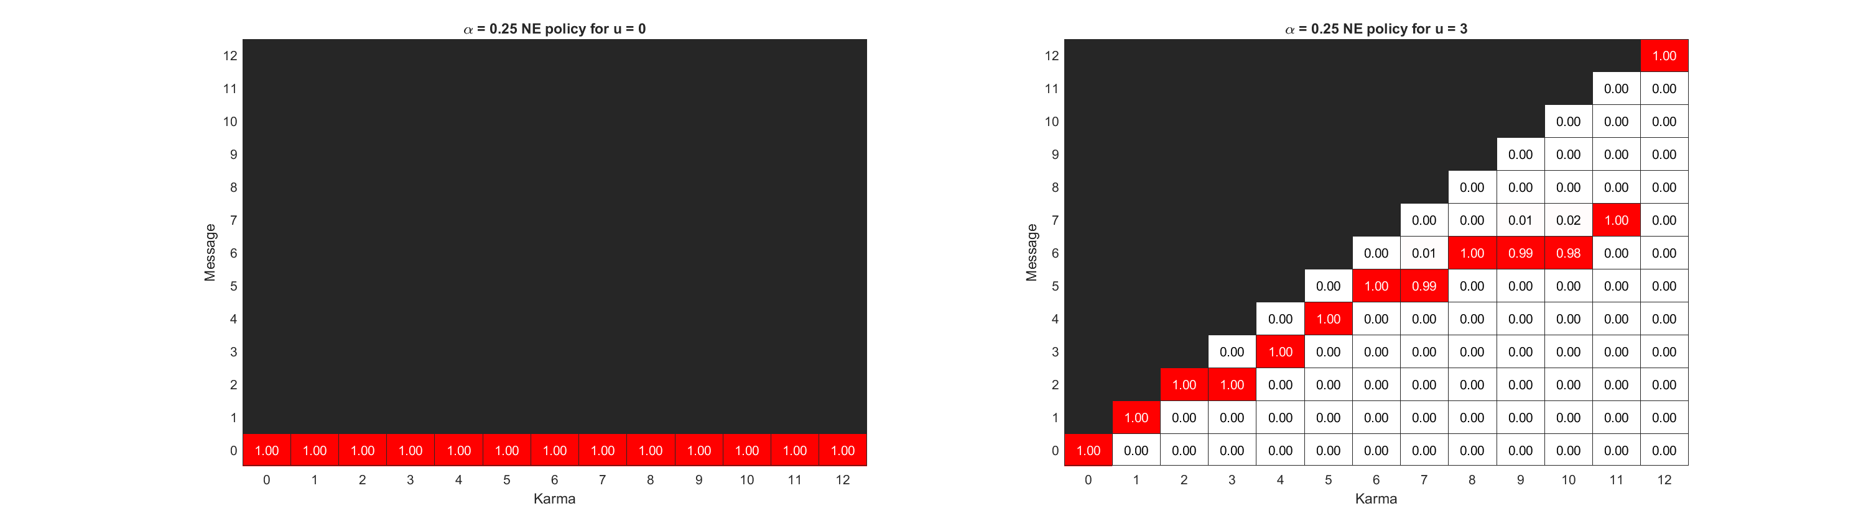

Notes:
Top: k_ave = 3, k_max = 12
Bottom: k_ave = 6, k_max = 12

Slide 7
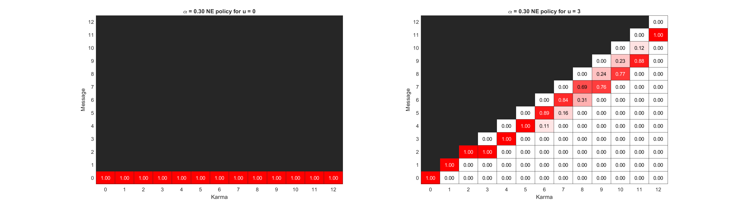
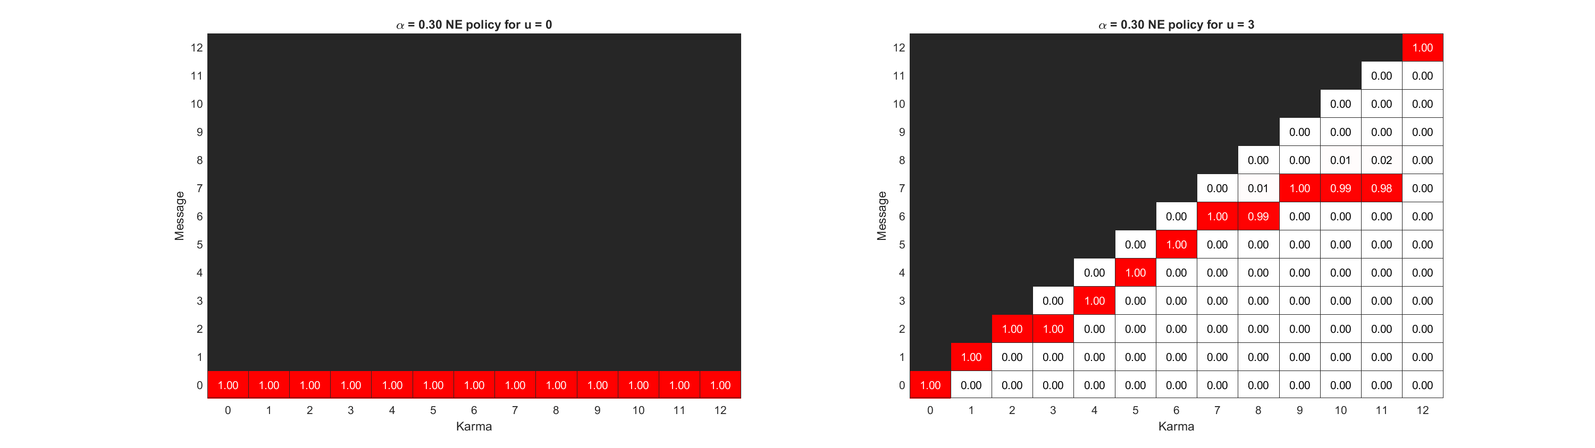
Notes:
Top: k_ave = 3, k_max = 12
Bottom: k_ave = 6, k_max = 12

Slide 8


Notes:
Top: k_ave = 3, k_max = 12
Bottom: k_ave = 6, k_max = 12

Slide 9


Notes:
Top: k_ave = 3, k_max = 12
Bottom: k_ave = 6, k_max = 12

Slide 10
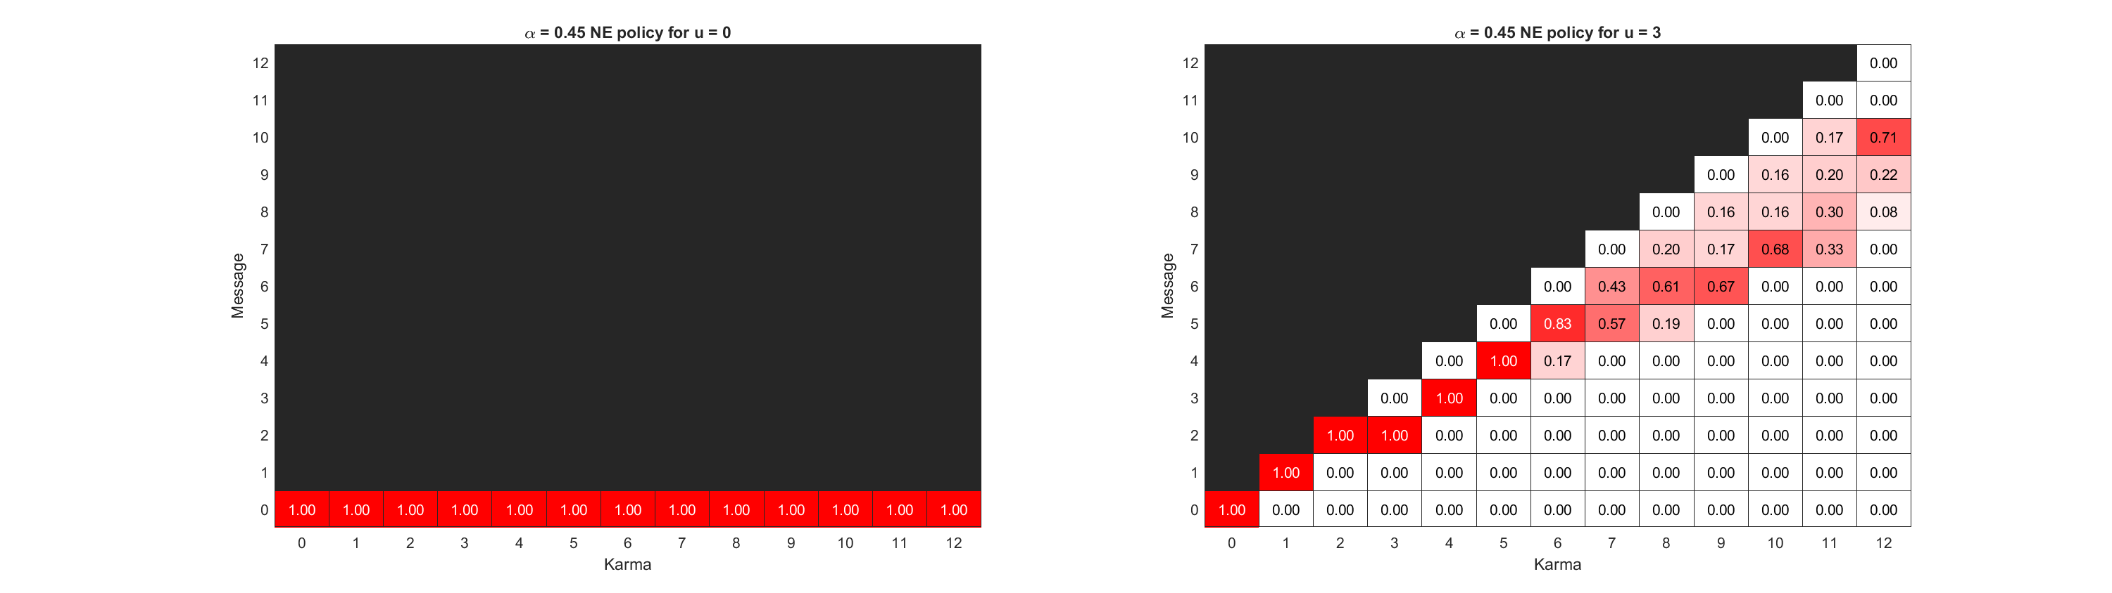
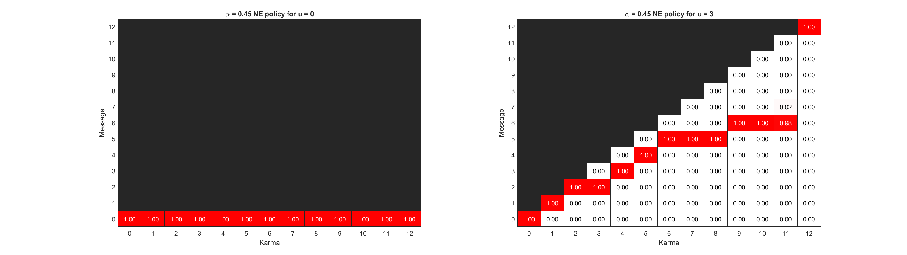
Notes:
Top: k_ave = 3, k_max = 12
Bottom: k_ave = 6, k_max = 12

Slide 11

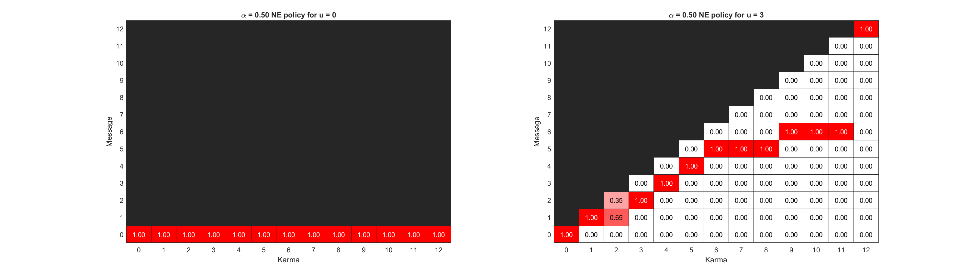
Notes:
Top: k_ave = 3, k_max = 12
Bottom: k_ave = 6, k_max = 12

Slide 12


Notes:
Top: k_ave = 3, k_max = 12
Bottom: k_ave = 6, k_max = 12

Slide 13

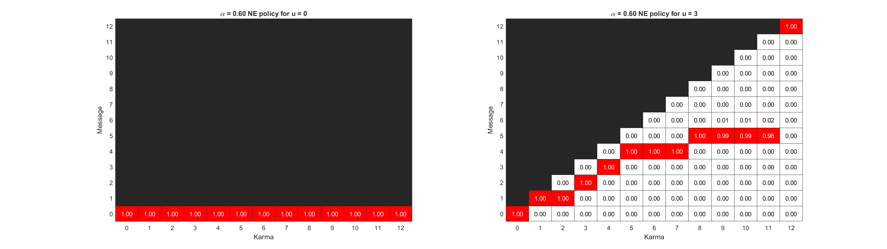
Notes:
Top: k_ave = 3, k_max = 12
Bottom: k_ave = 6, k_max = 12

Slide 14
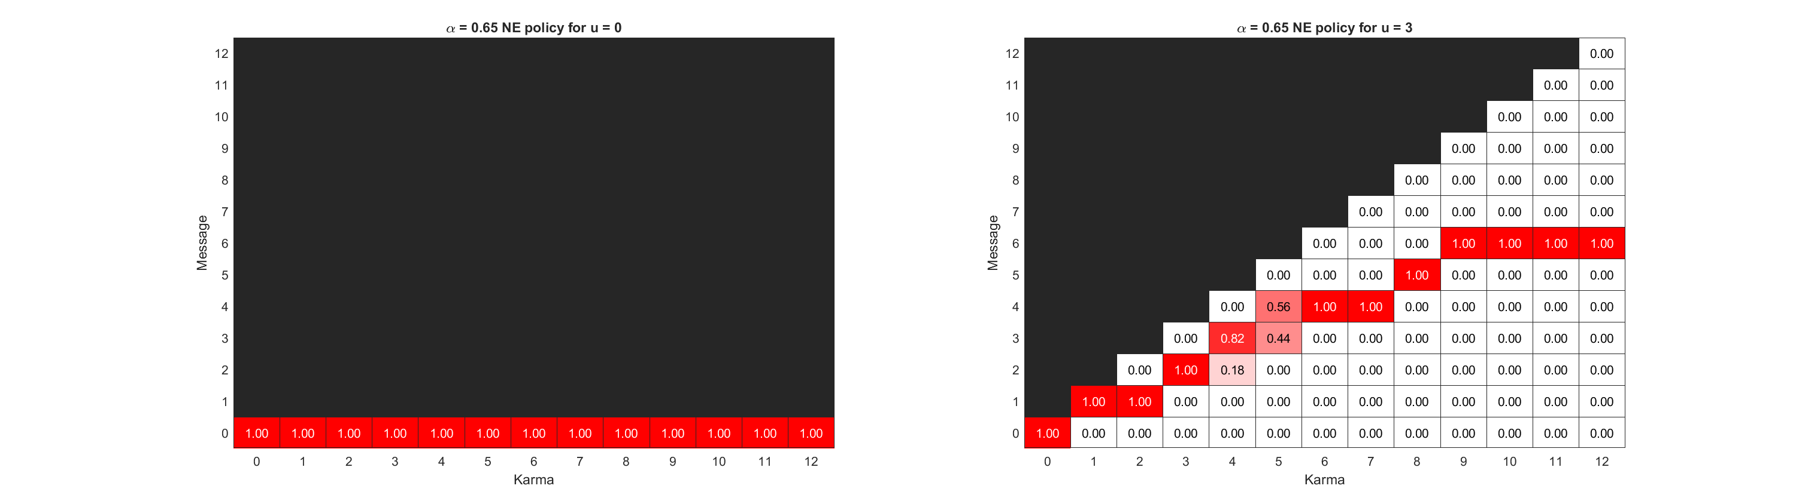

Notes:
Top: k_ave = 3, k_max = 12
Bottom: k_ave = 6, k_max = 12

Slide 15
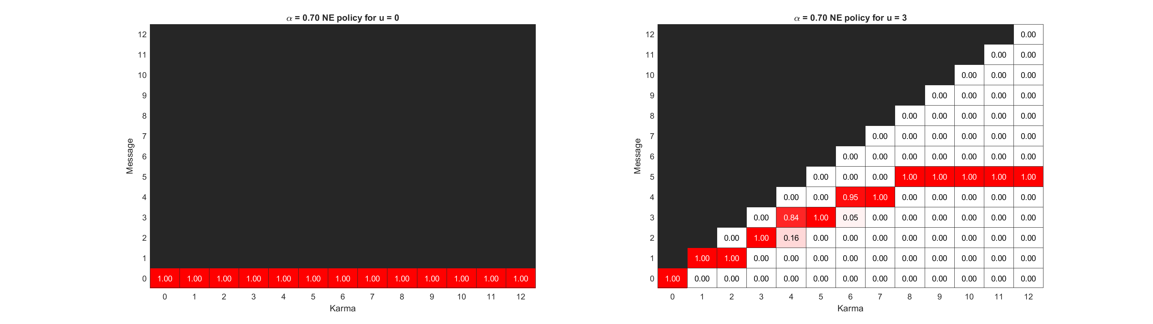

Notes:
Top: k_ave = 3, k_max = 12
Bottom: k_ave = 6, k_max = 12

Slide 16
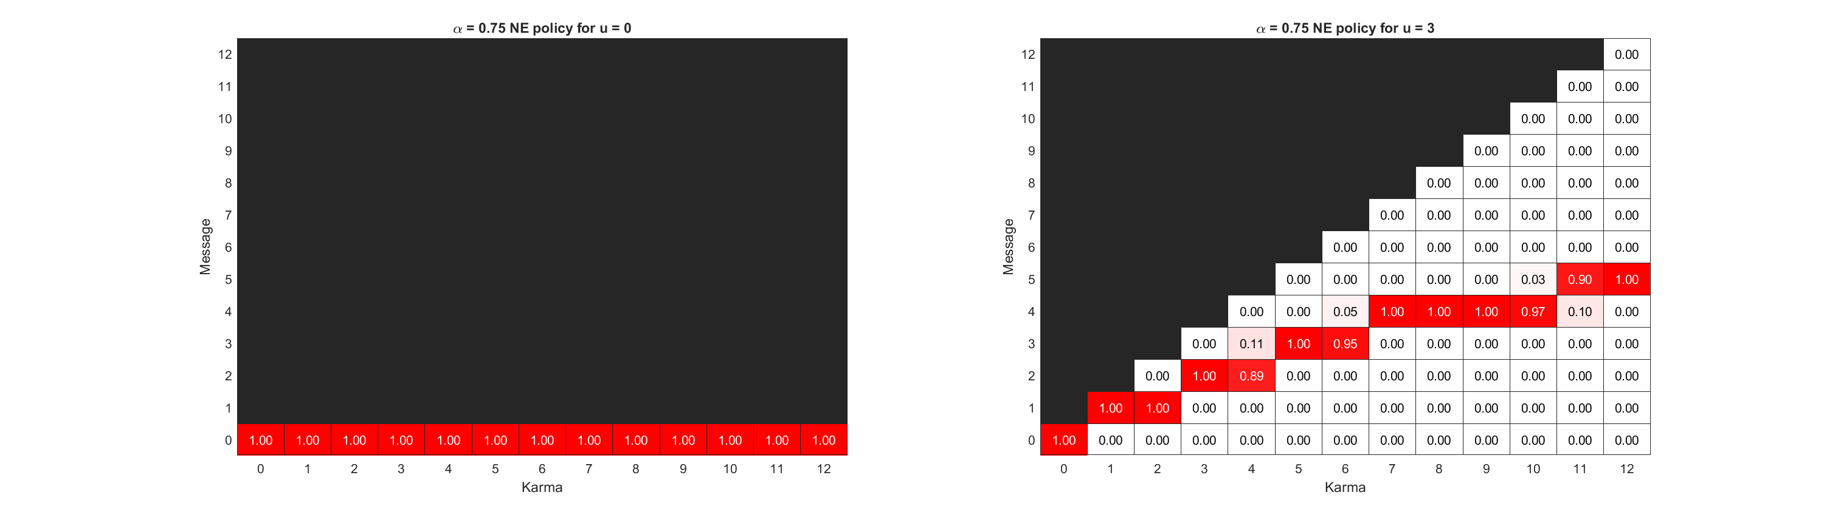
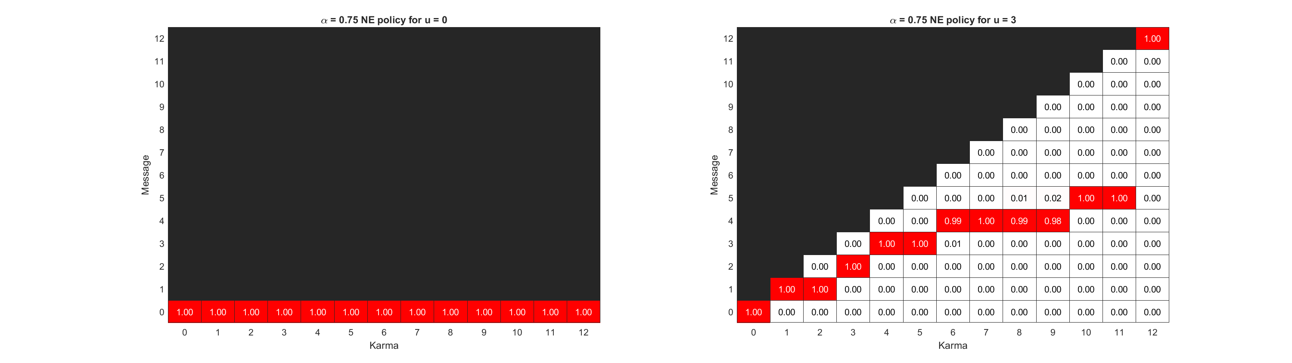
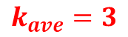
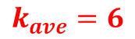
$$k_{ave}=3$$
$$k_{ave}=6$$
Notes:
Top: k_ave = 3, k_max = 12
Bottom: k_ave = 6, k_max = 12

Slide 17
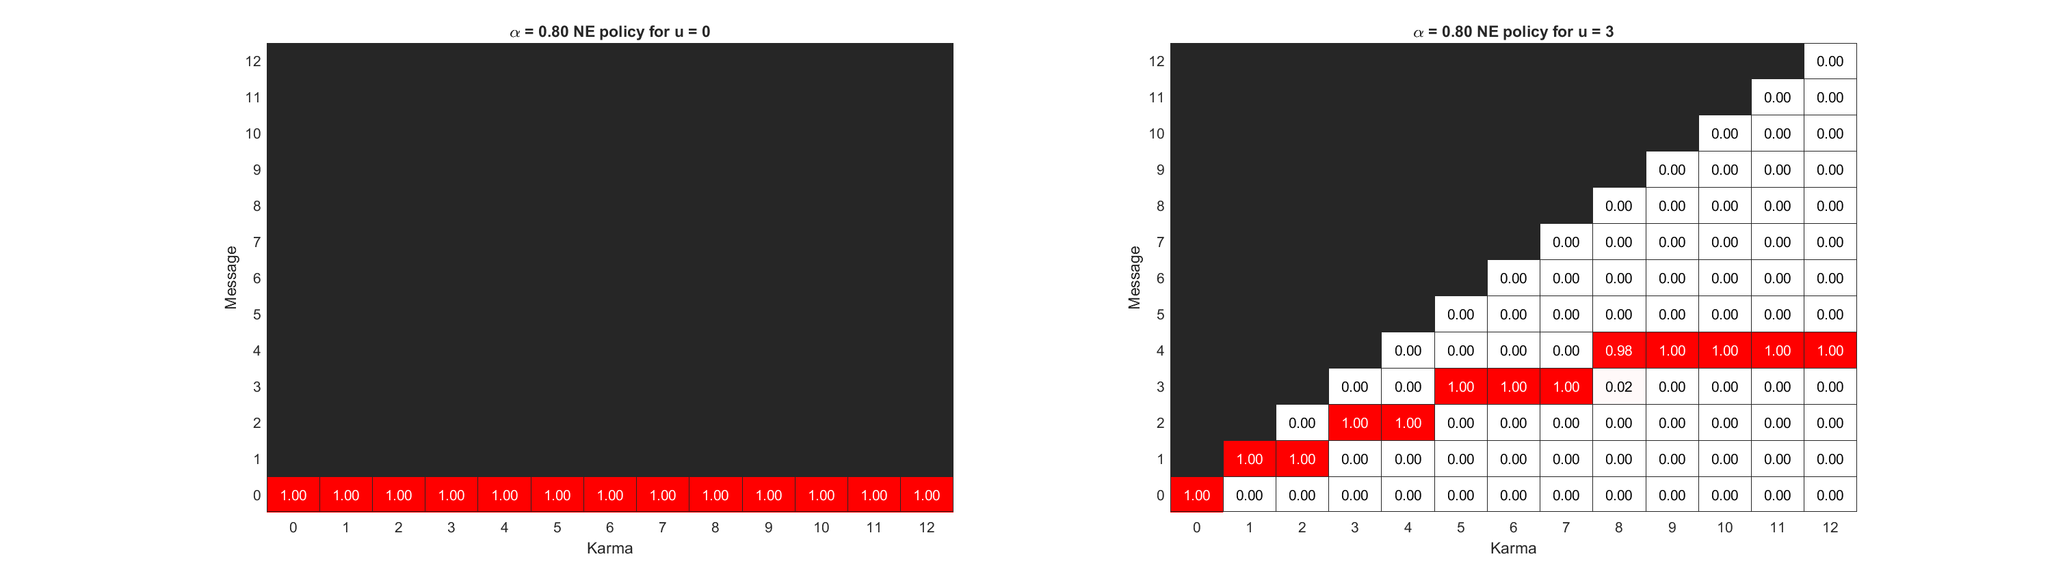
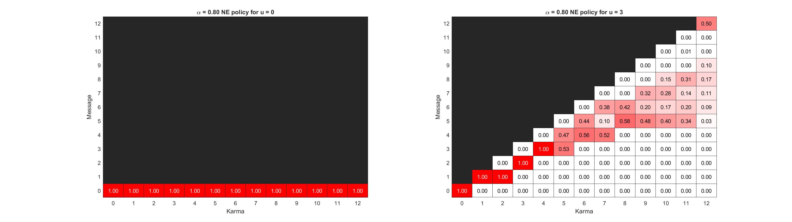
Notes:
Top: k_ave = 3, k_max = 12
Bottom: k_ave = 6, k_max = 12

Slide 18
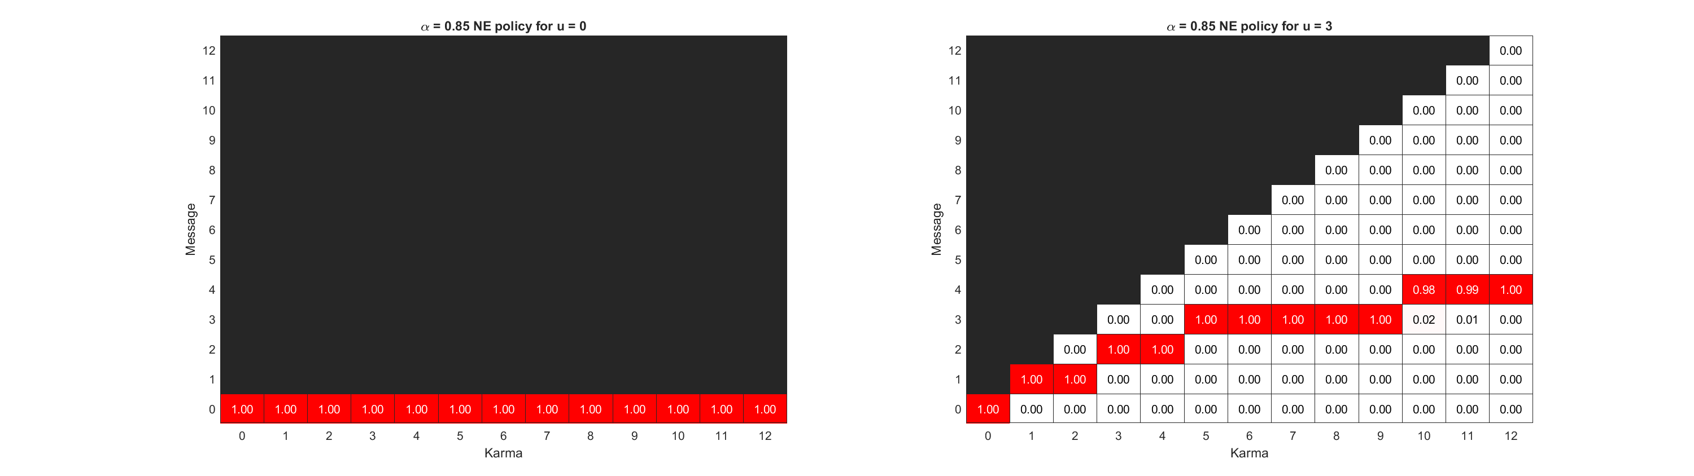

Notes:
Top: k_ave = 3, k_max = 12
Bottom: k_ave = 6, k_max = 12

Slide 19
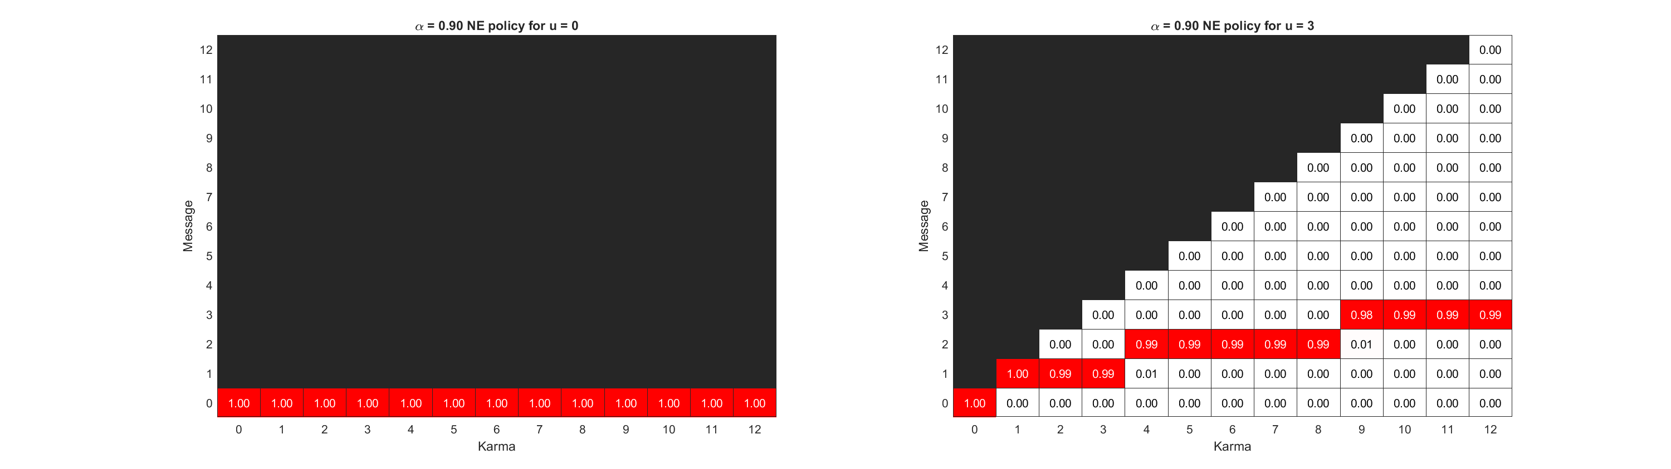
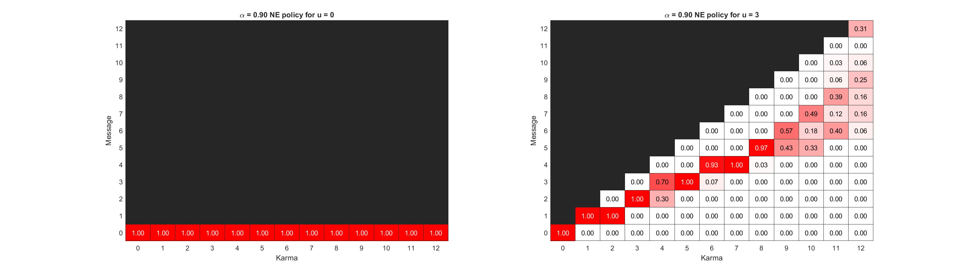
Notes:
Top: k_ave = 3, k_max = 12
Bottom: k_ave = 6, k_max = 12

Slide 20
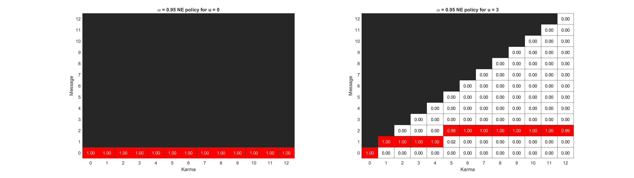
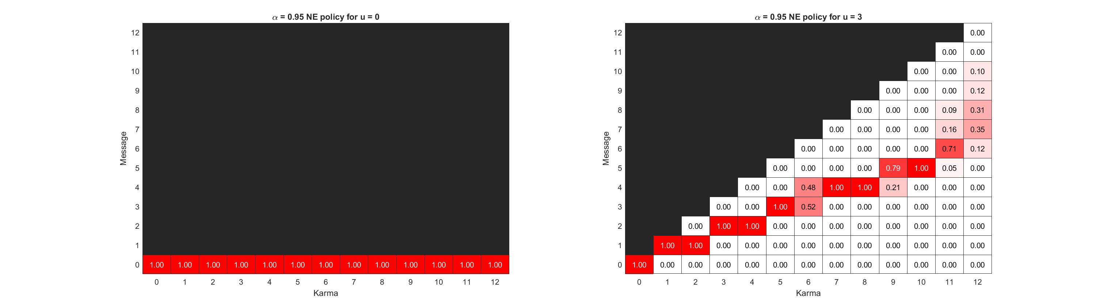
Notes:
Top: k_ave = 3, k_max = 12
Bottom: k_ave = 6, k_max = 12

Slide 21
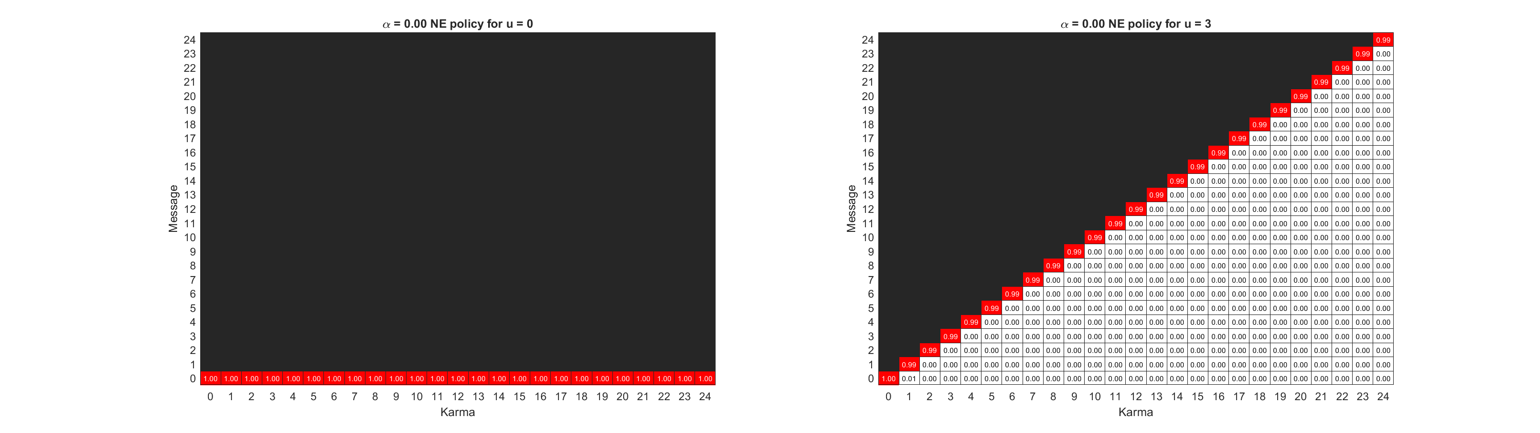
Notes:
Top: k_ave = 6, k_max = 24
Bottom: k_ave = 6, k_max = 12

Slide 22
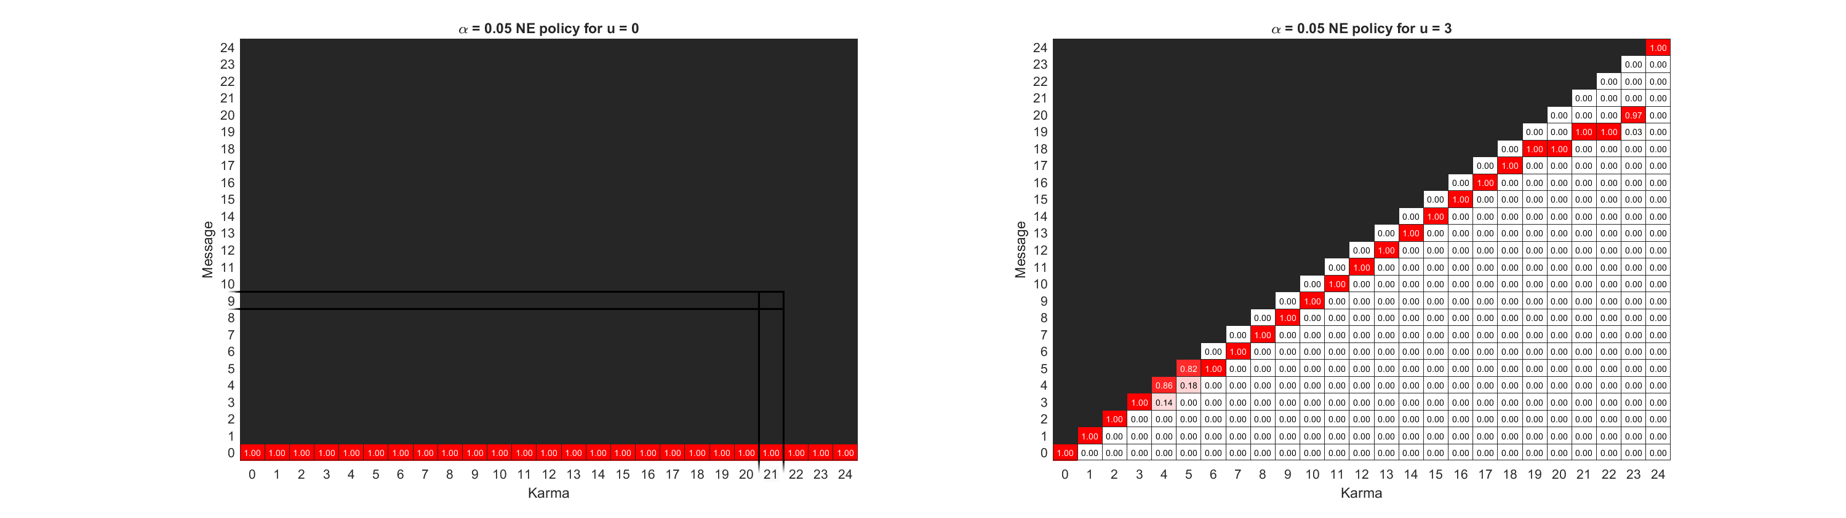
Notes:
Top: k_ave = 6, k_max = 24
Bottom: k_ave = 6, k_max = 12

Slide 23

Notes:
Top: k_ave = 6, k_max = 24
Bottom: k_ave = 6, k_max = 12

Slide 24
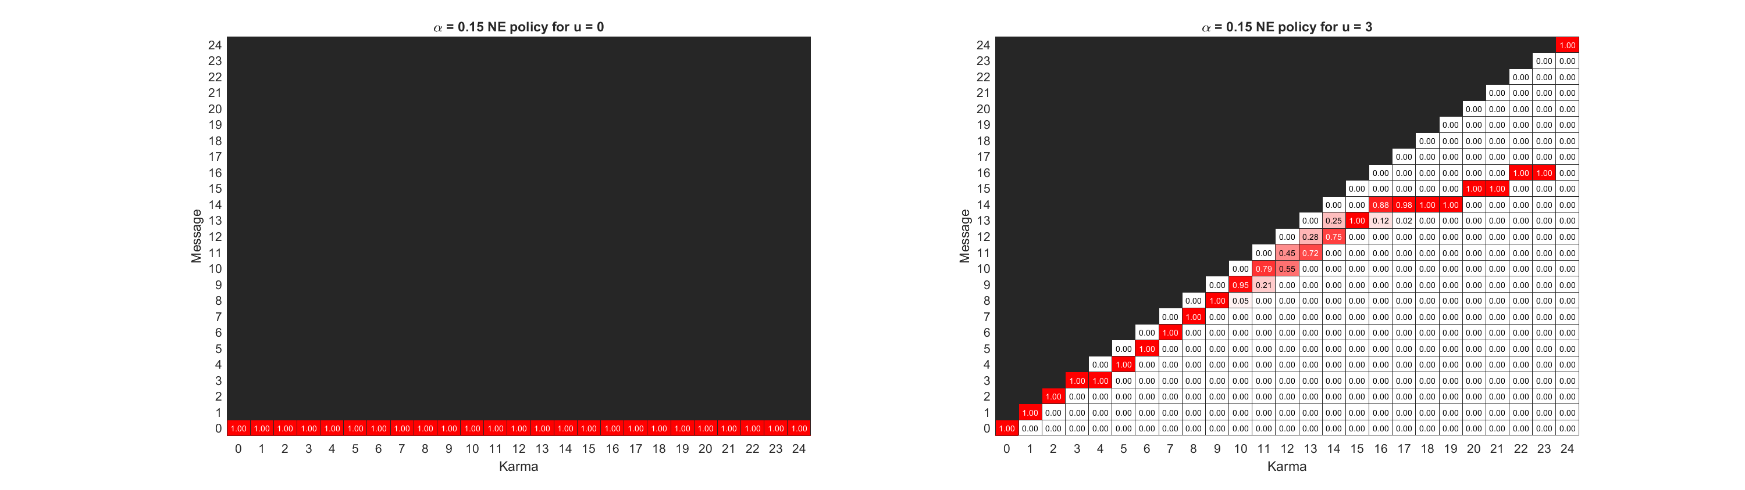
Notes:
Top: k_ave = 6, k_max = 24
Bottom: k_ave = 6, k_max = 12

Slide 25
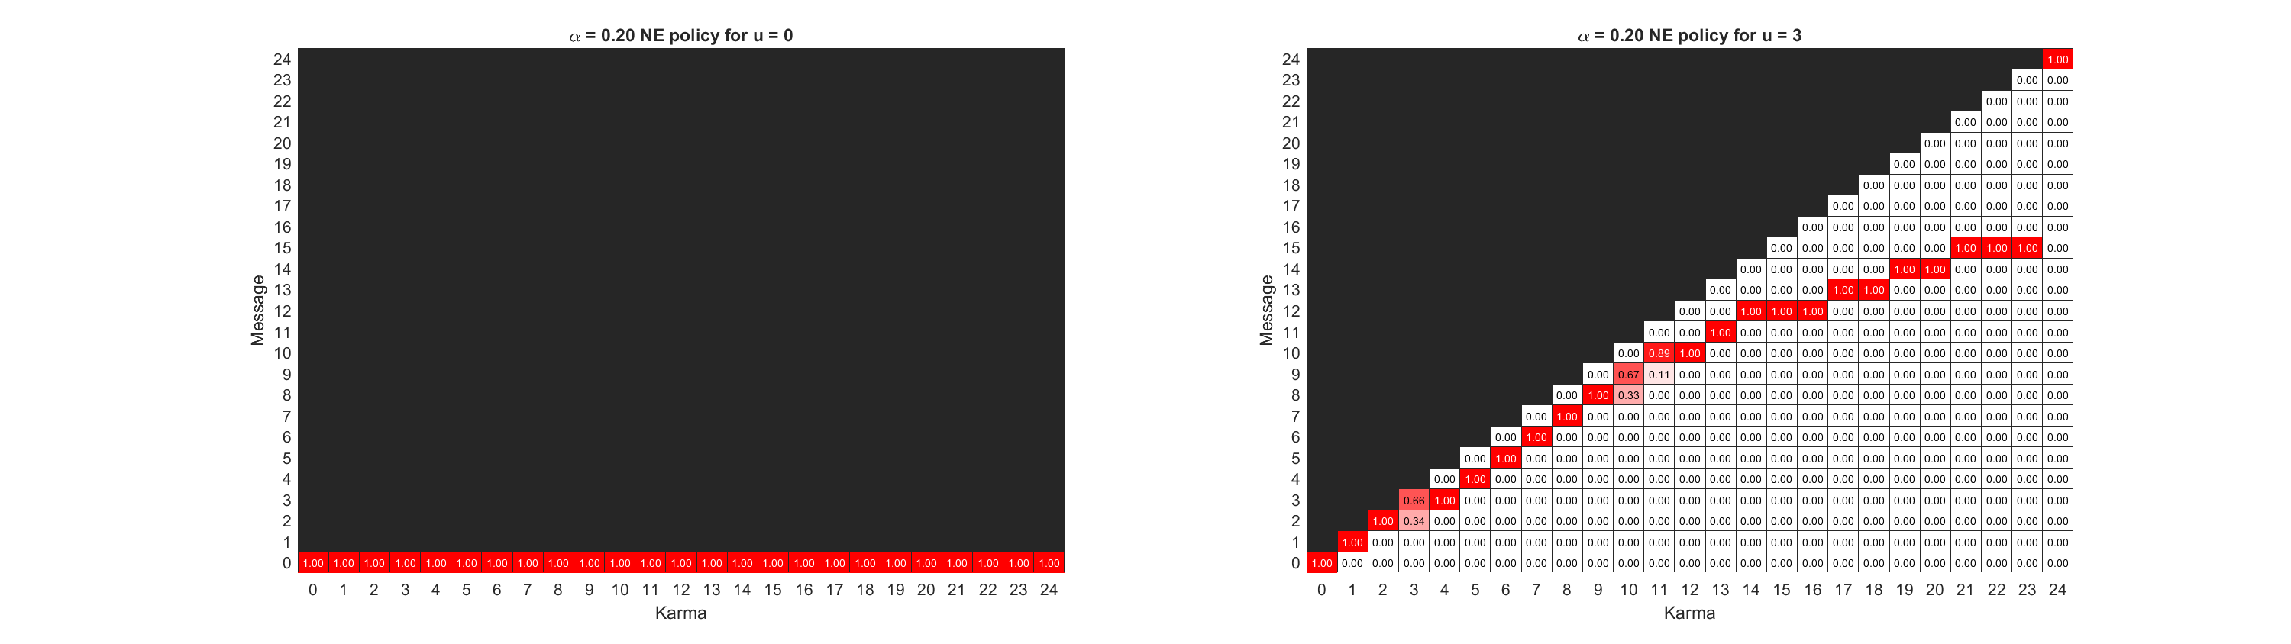
Notes:
Top: k_ave = 6, k_max = 24
Bottom: k_ave = 6, k_max = 12

Slide 26

Notes:
Top: k_ave = 6, k_max = 24
Bottom: k_ave = 6, k_max = 12

Slide 27

Notes:
Top: k_ave = 6, k_max = 24
Bottom: k_ave = 6, k_max = 12

Slide 28

Notes:
Top: k_ave = 6, k_max = 24
Bottom: k_ave = 6, k_max = 12

Slide 29

Notes:
Top: k_ave = 6, k_max = 24
Bottom: k_ave = 6, k_max = 12

Slide 30

Notes:
Top: k_ave = 6, k_max = 24
Bottom: k_ave = 6, k_max = 12

Slide 31

Notes:
Top: k_ave = 6, k_max = 24
Bottom: k_ave = 6, k_max = 12

Slide 32

Notes:
Top: k_ave = 6, k_max = 24
Bottom: k_ave = 6, k_max = 12

Slide 33

Notes:
Top: k_ave = 6, k_max = 24
Bottom: k_ave = 6, k_max = 12

Slide 34
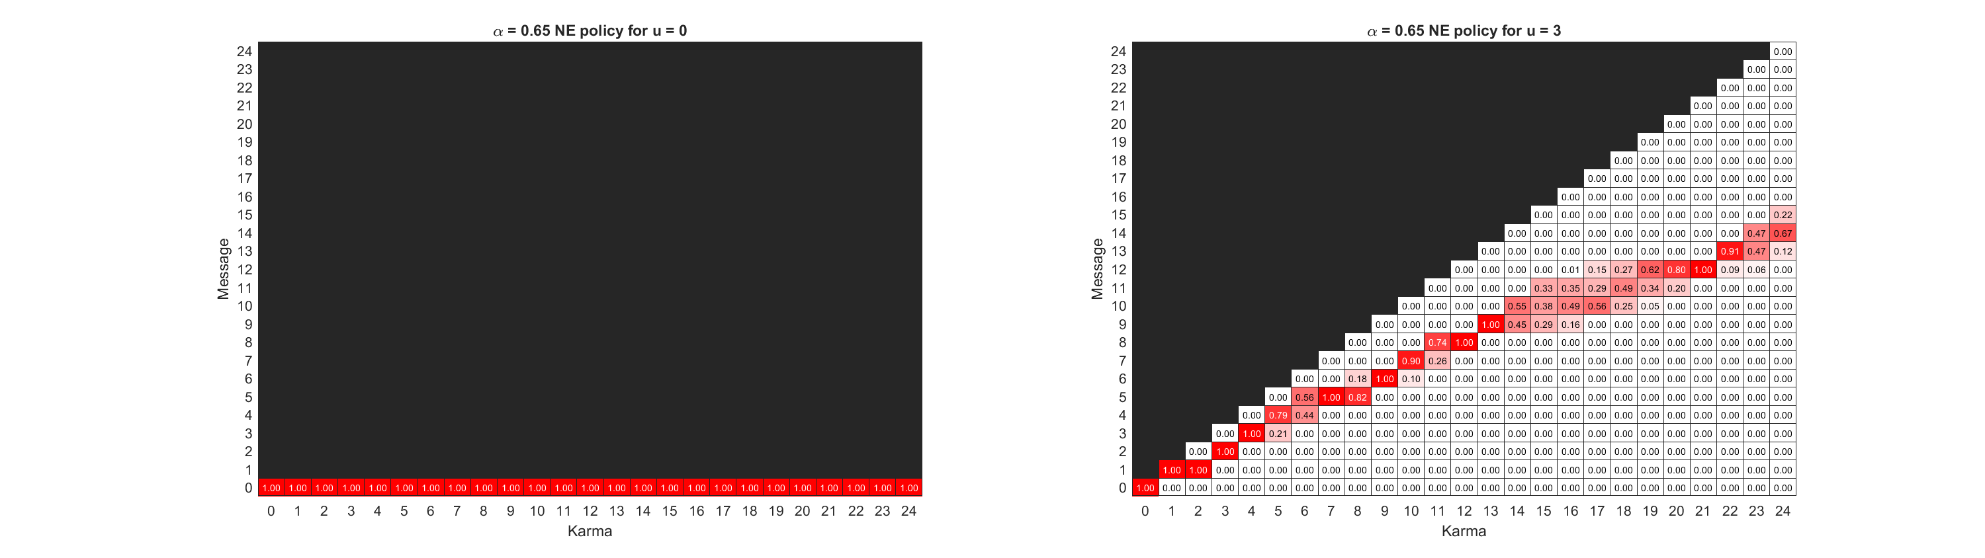
Notes:
Top: k_ave = 6, k_max = 24
Bottom: k_ave = 6, k_max = 12

Slide 35
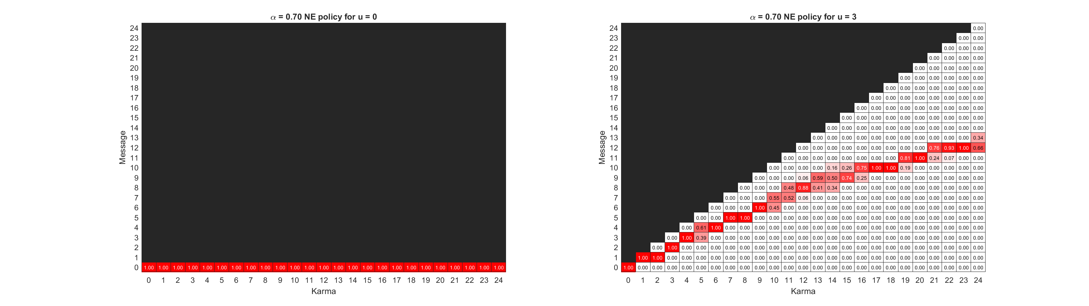
Notes:
Top: k_ave = 6, k_max = 24
Bottom: k_ave = 6, k_max = 12

Slide 36
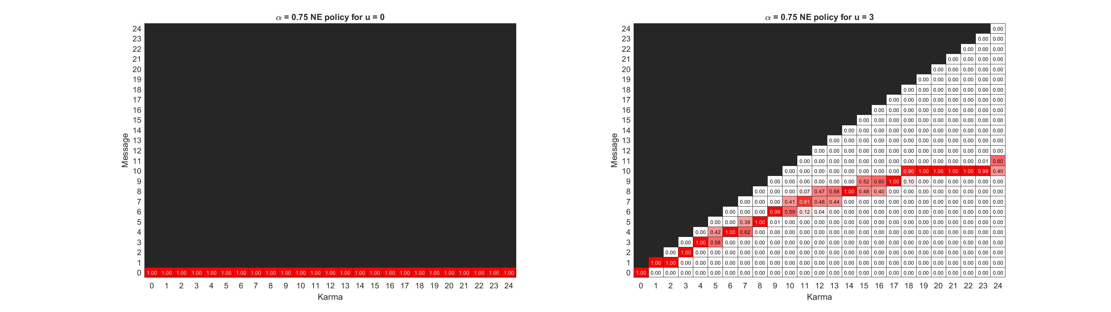
Notes:
Top: k_ave = 6, k_max = 24
Bottom: k_ave = 6, k_max = 12

Slide 37
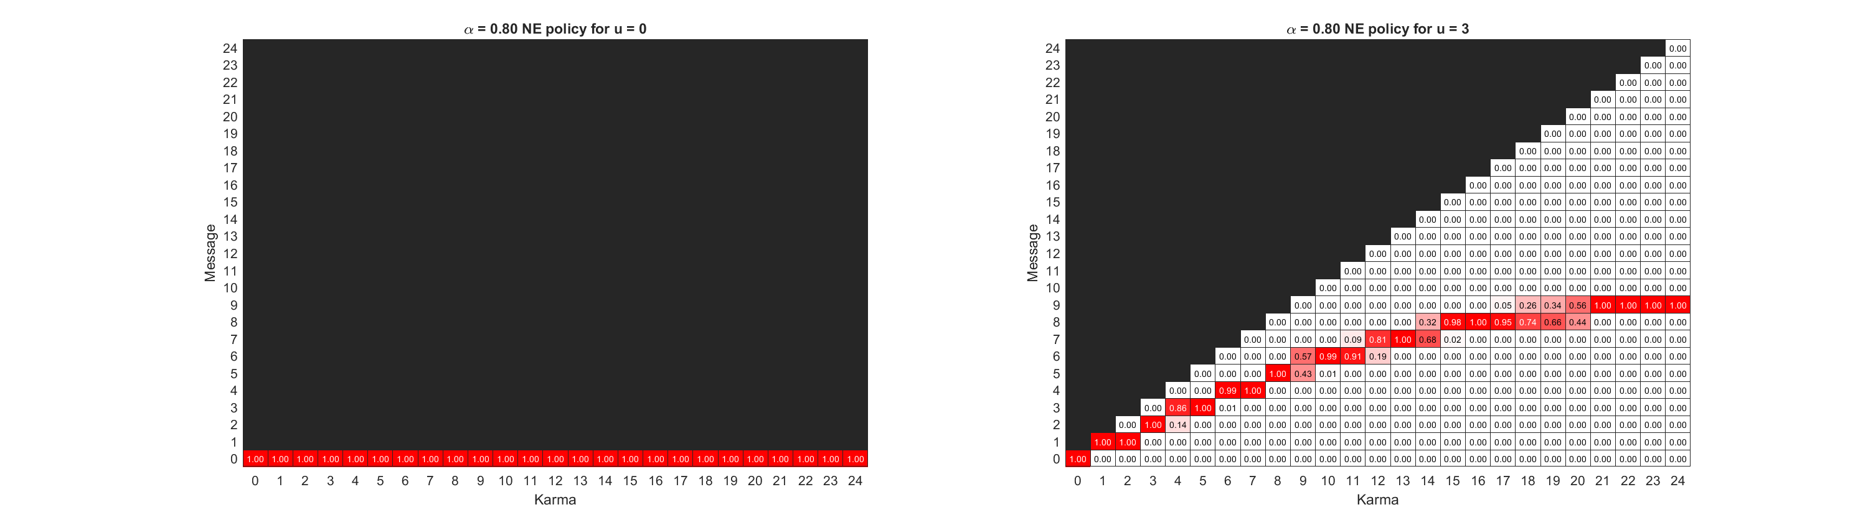
Notes:
Top: k_ave = 6, k_max = 24
Bottom: k_ave = 6, k_max = 12

Slide 38
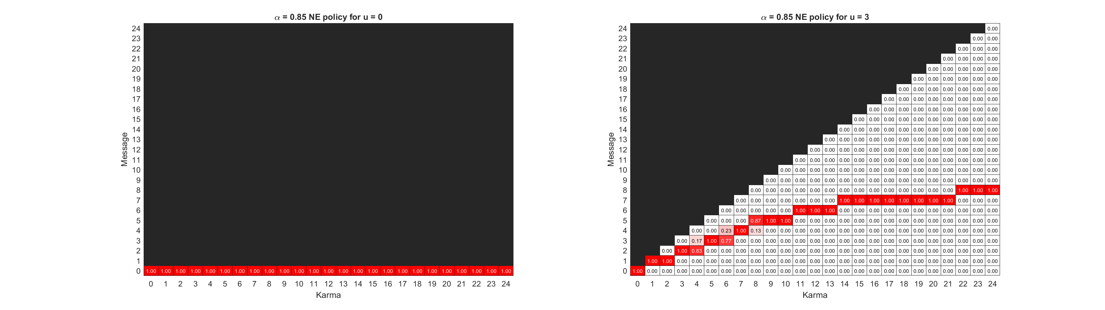
Notes:
Top: k_ave = 6, k_max = 24
Bottom: k_ave = 6, k_max = 12

Slide 39
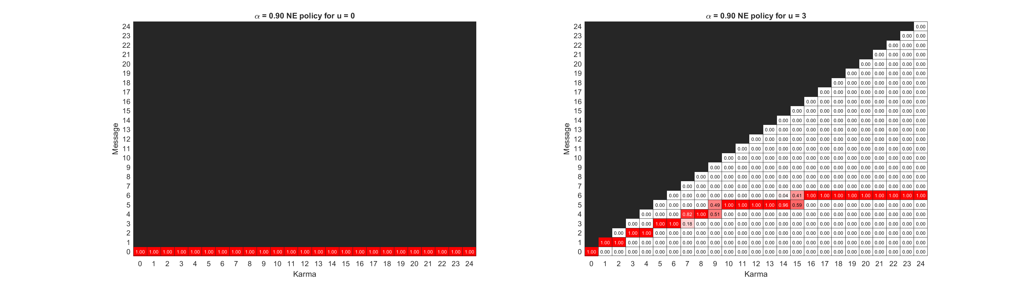
Notes:
Top: k_ave = 6, k_max = 24
Bottom: k_ave = 6, k_max = 12

Slide 40
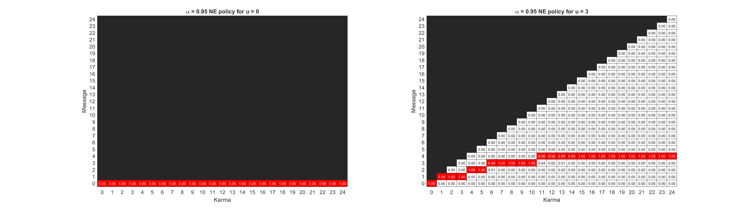
Notes:
Top: k_ave = 6, k_max = 24
Bottom: k_ave = 6, k_max = 12

Slide 41
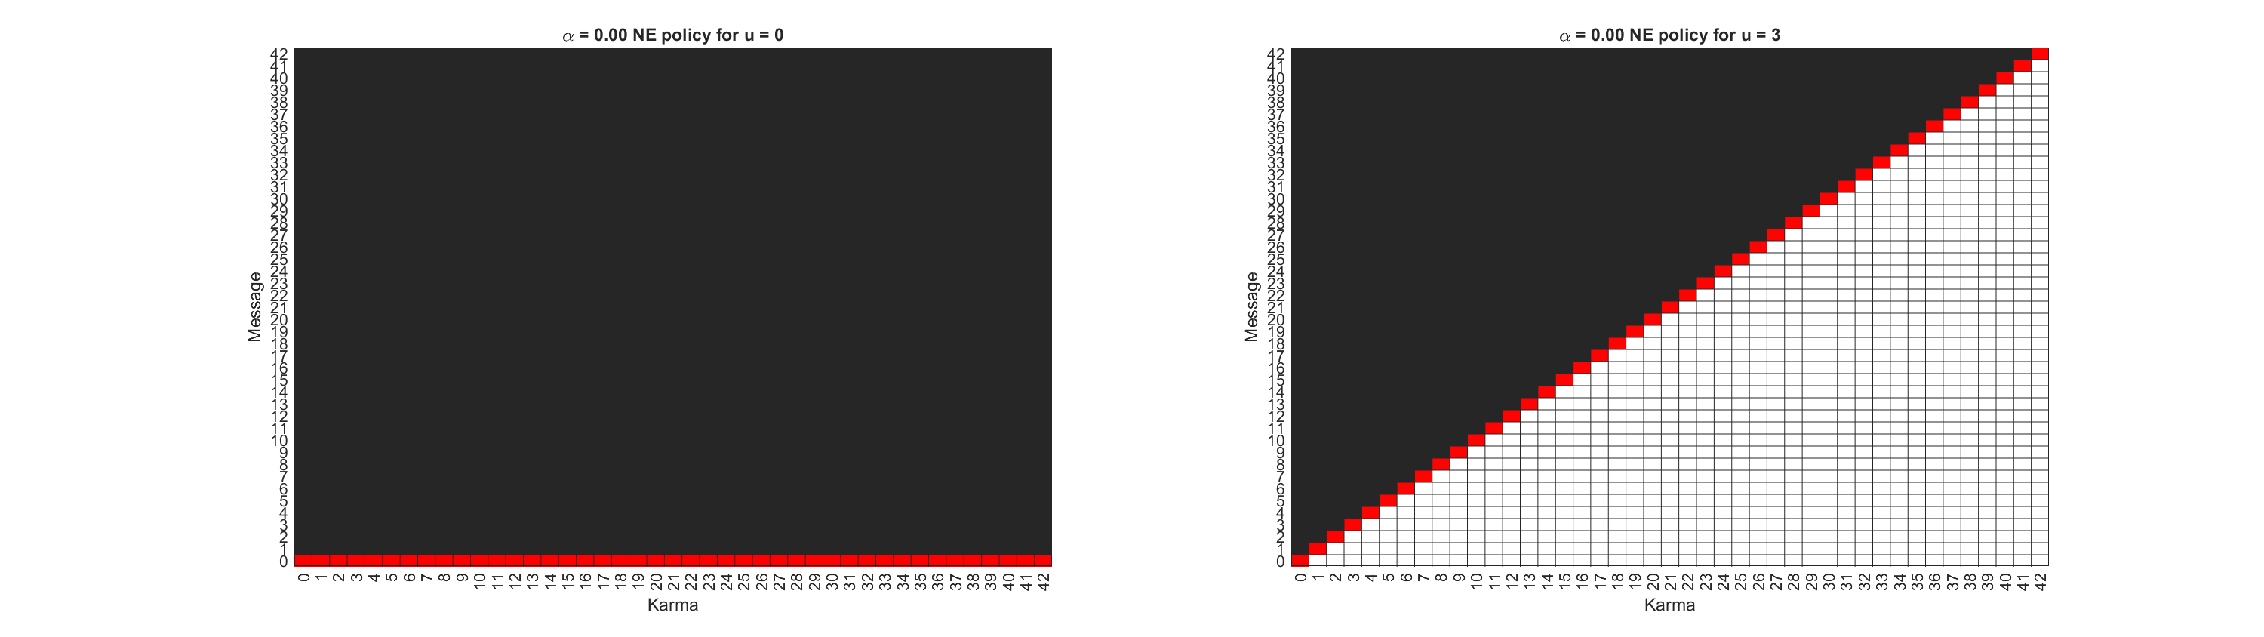
Notes:
Top: k_ave = 6, k_max = 42
Bottom: k_ave = 6, k_max = 12

Slide 42

Notes:
Top: k_ave = 6, k_max = 42
Bottom: k_ave = 6, k_max = 12

Slide 43
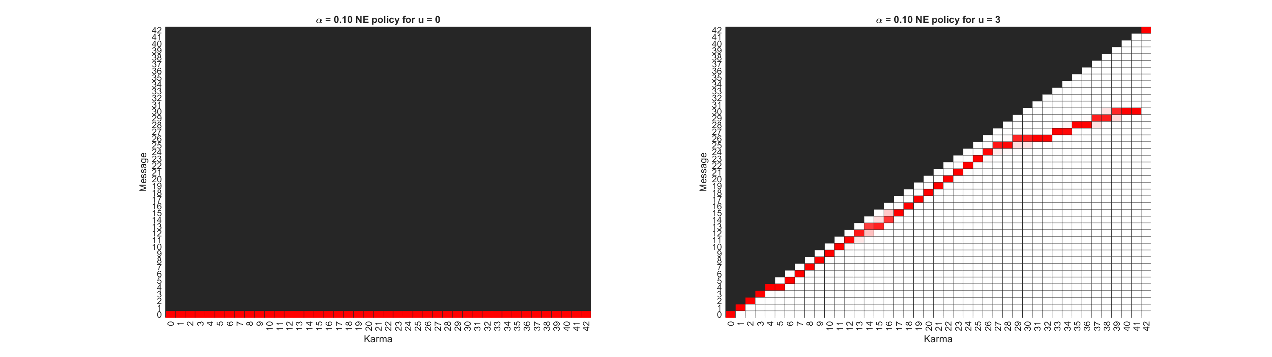
Notes:
Top: k_ave = 6, k_max = 42
Bottom: k_ave = 6, k_max = 12

Slide 44
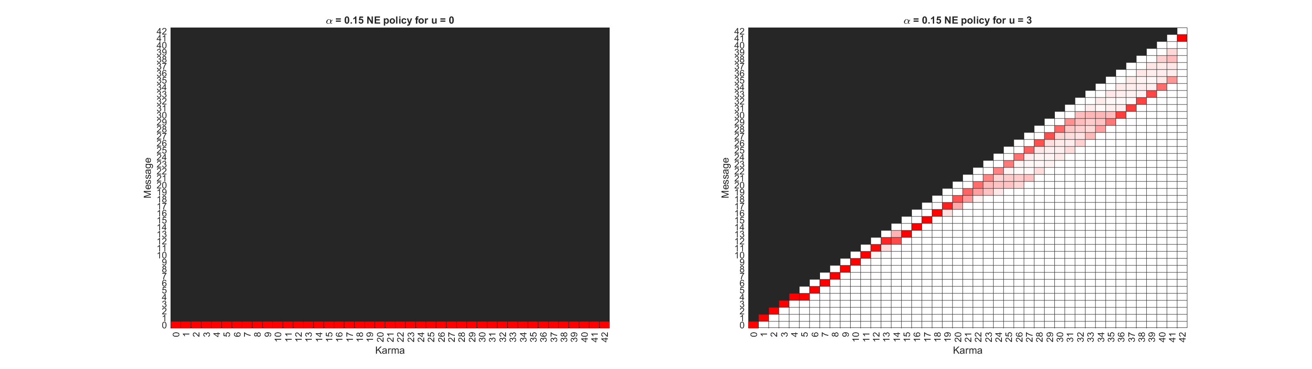
Notes:
Top: k_ave = 6, k_max = 42
Bottom: k_ave = 6, k_max = 12

Slide 45

Notes:
Top: k_ave = 6, k_max = 42
Bottom: k_ave = 6, k_max = 12

Slide 46

Notes:
Top: k_ave = 6, k_max = 42
Bottom: k_ave = 6, k_max = 12

Slide 47

Notes:
Top: k_ave = 6, k_max = 42
Bottom: k_ave = 6, k_max = 12

Slide 48

Notes:
Top: k_ave = 6, k_max = 42
Bottom: k_ave = 6, k_max = 12

Slide 49
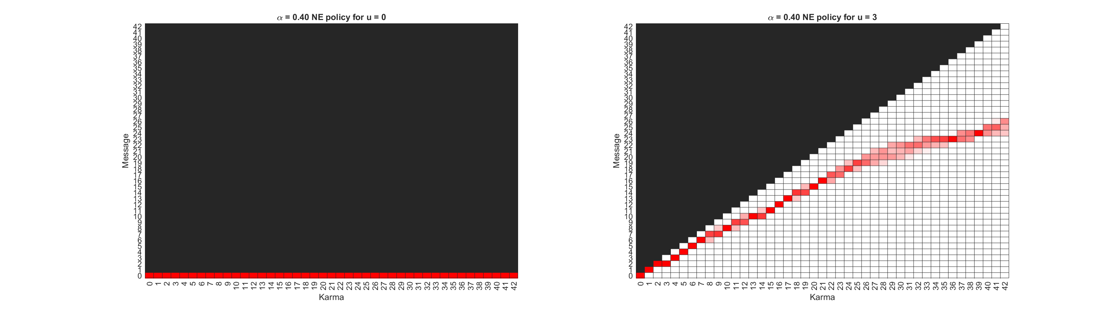
Notes:
Top: k_ave = 6, k_max = 42
Bottom: k_ave = 6, k_max = 12

Slide 50
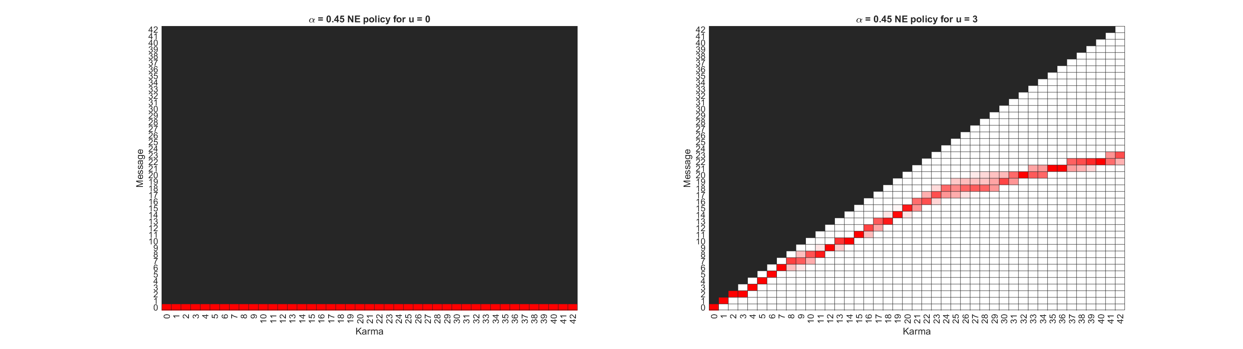
Notes:
Top: k_ave = 6, k_max = 42
Bottom: k_ave = 6, k_max = 12

Slide 51
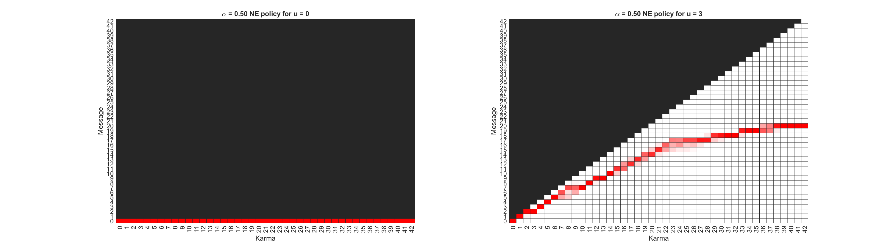
Notes:
Top: k_ave = 6, k_max = 42
Bottom: k_ave = 6, k_max = 12

Slide 52
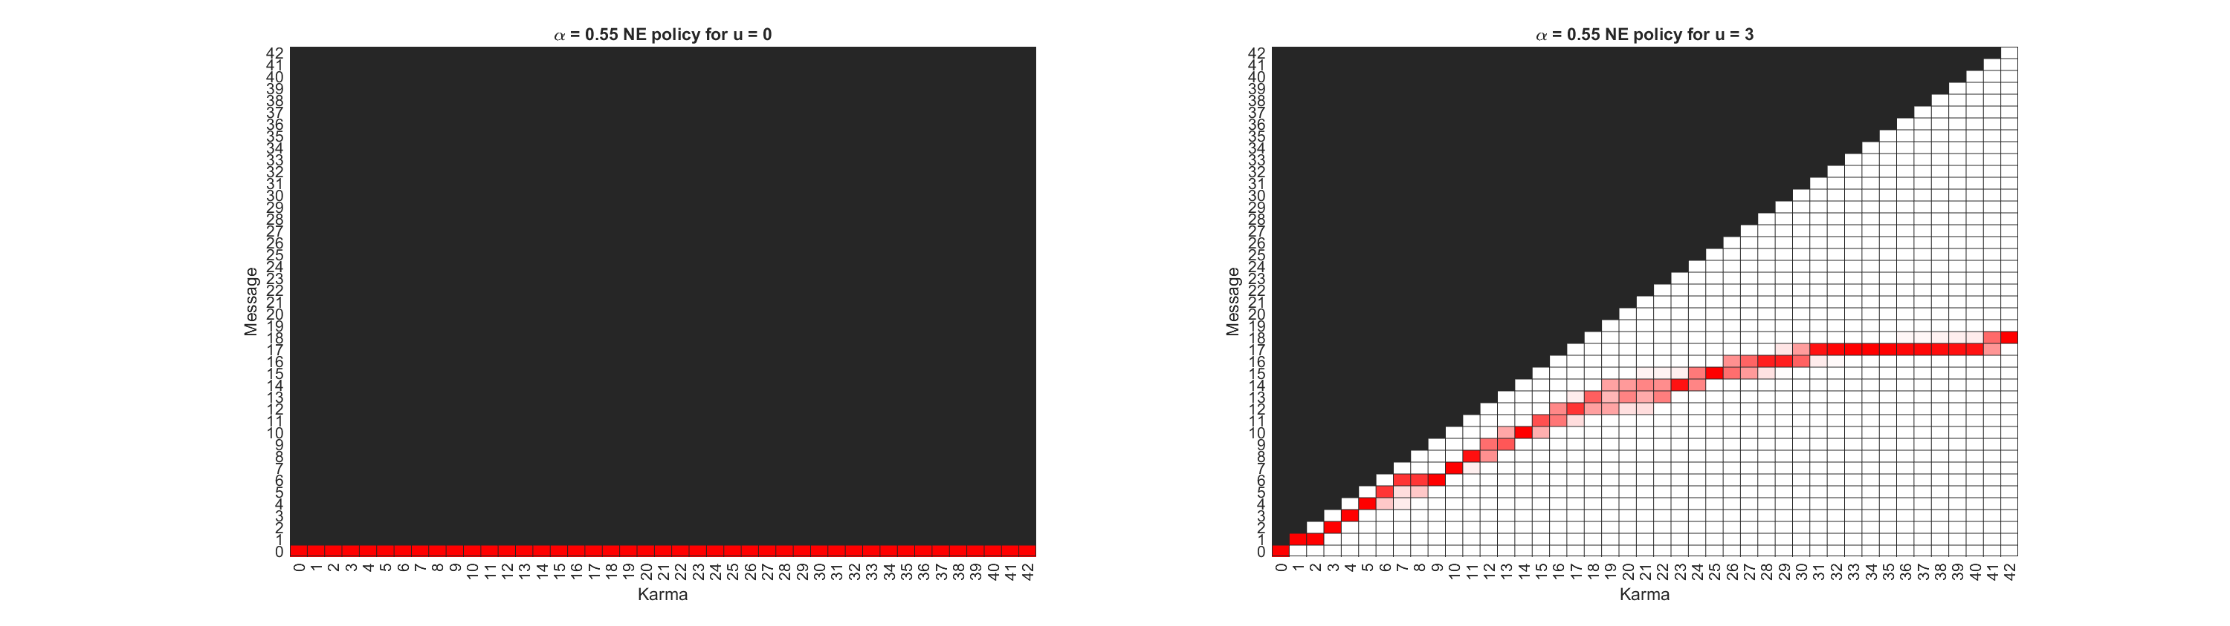
Notes:
Top: k_ave = 6, k_max = 42
Bottom: k_ave = 6, k_max = 12

Slide 53

Notes:
Top: k_ave = 6, k_max = 42
Bottom: k_ave = 6, k_max = 12

Slide 54
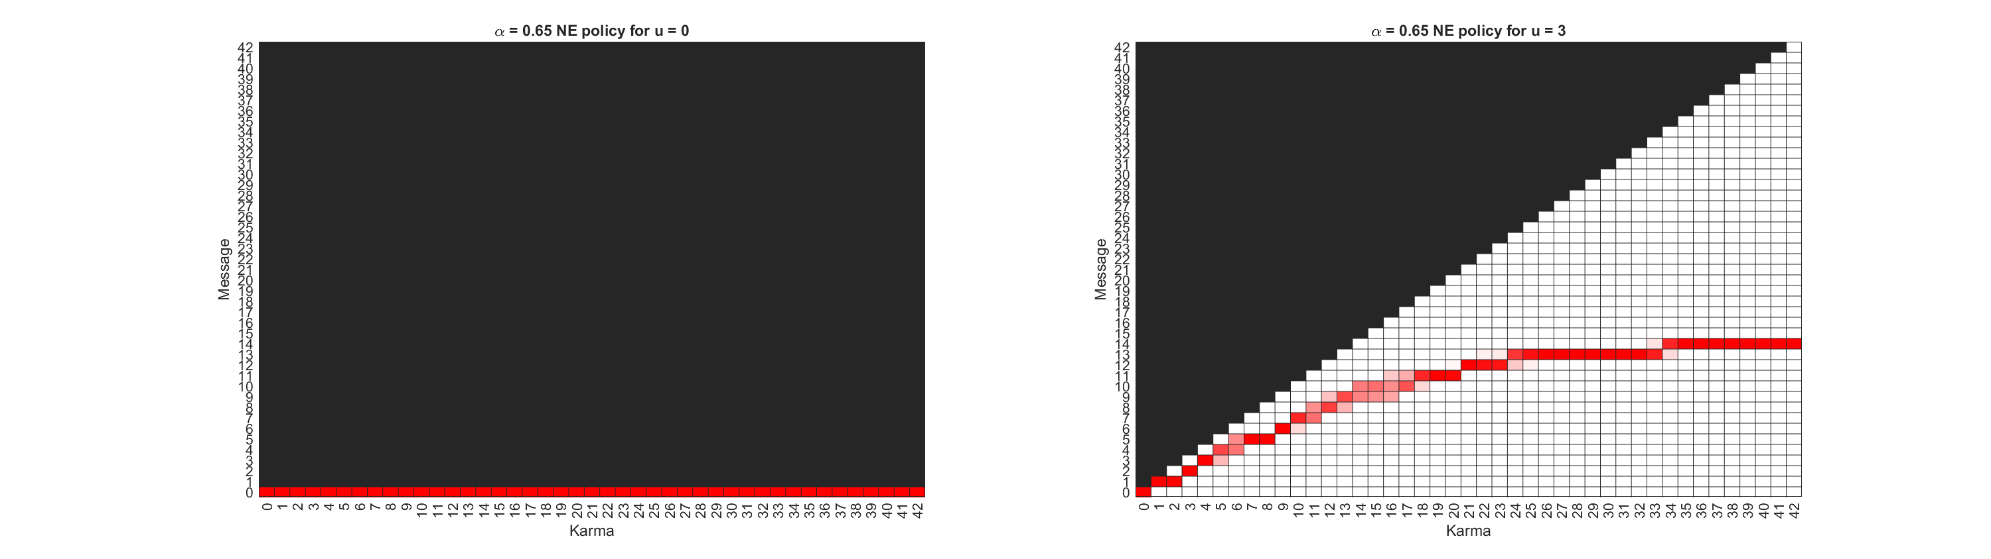
Notes:
Top: k_ave = 6, k_max = 42
Bottom: k_ave = 6, k_max = 12

Slide 55
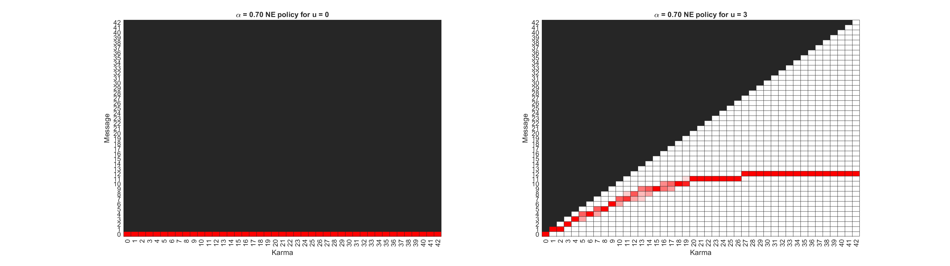
Notes:
Top: k_ave = 6, k_max = 42
Bottom: k_ave = 6, k_max = 12

Slide 56

Notes:
Top: k_ave = 6, k_max = 42
Bottom: k_ave = 6, k_max = 12

Slide 57

Notes:
Top: k_ave = 6, k_max = 42
Bottom: k_ave = 6, k_max = 12

Slide 58
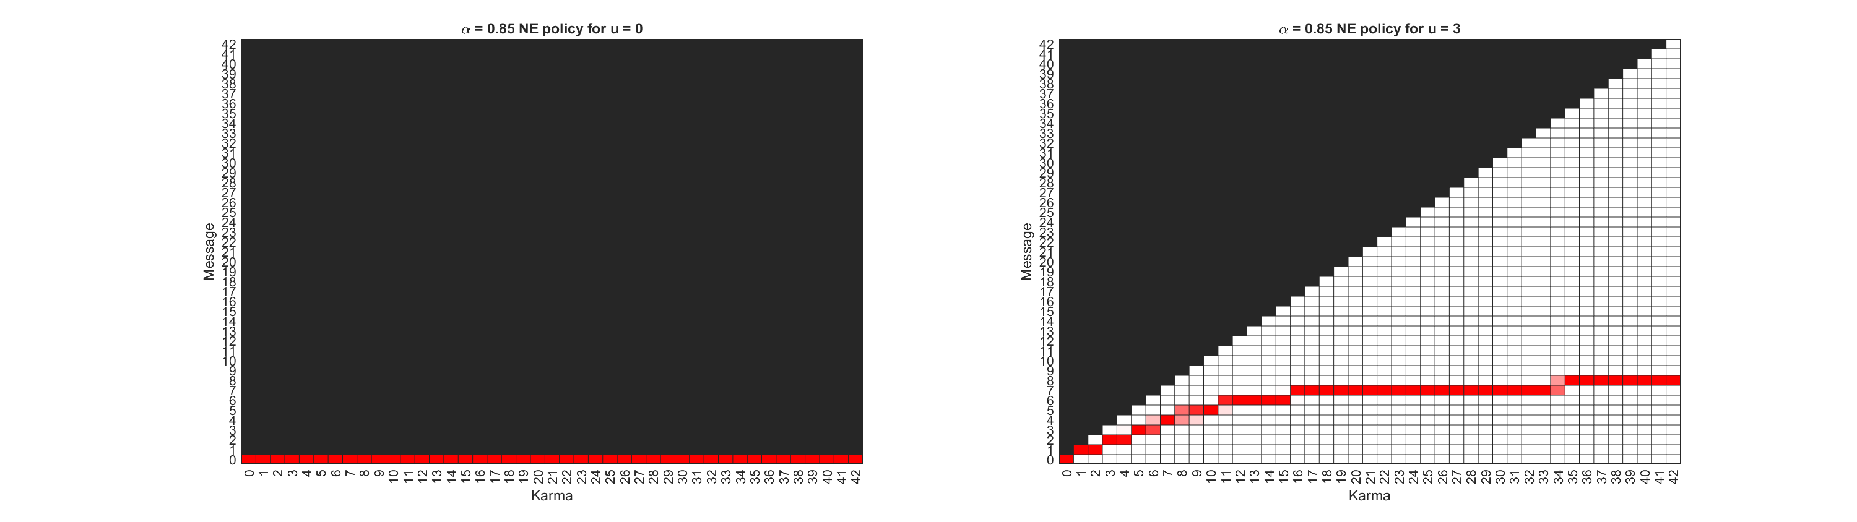
Notes:
Top: k_ave = 6, k_max = 42
Bottom: k_ave = 6, k_max = 12

Slide 59

Notes:
Top: k_ave = 6, k_max = 42
Bottom: k_ave = 6, k_max = 12

Slide 60
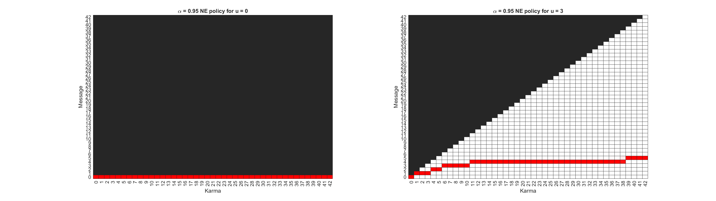
Notes:
Top: k_ave = 6, k_max = 42
Bottom: k_ave = 6, k_max = 12

Slide 61
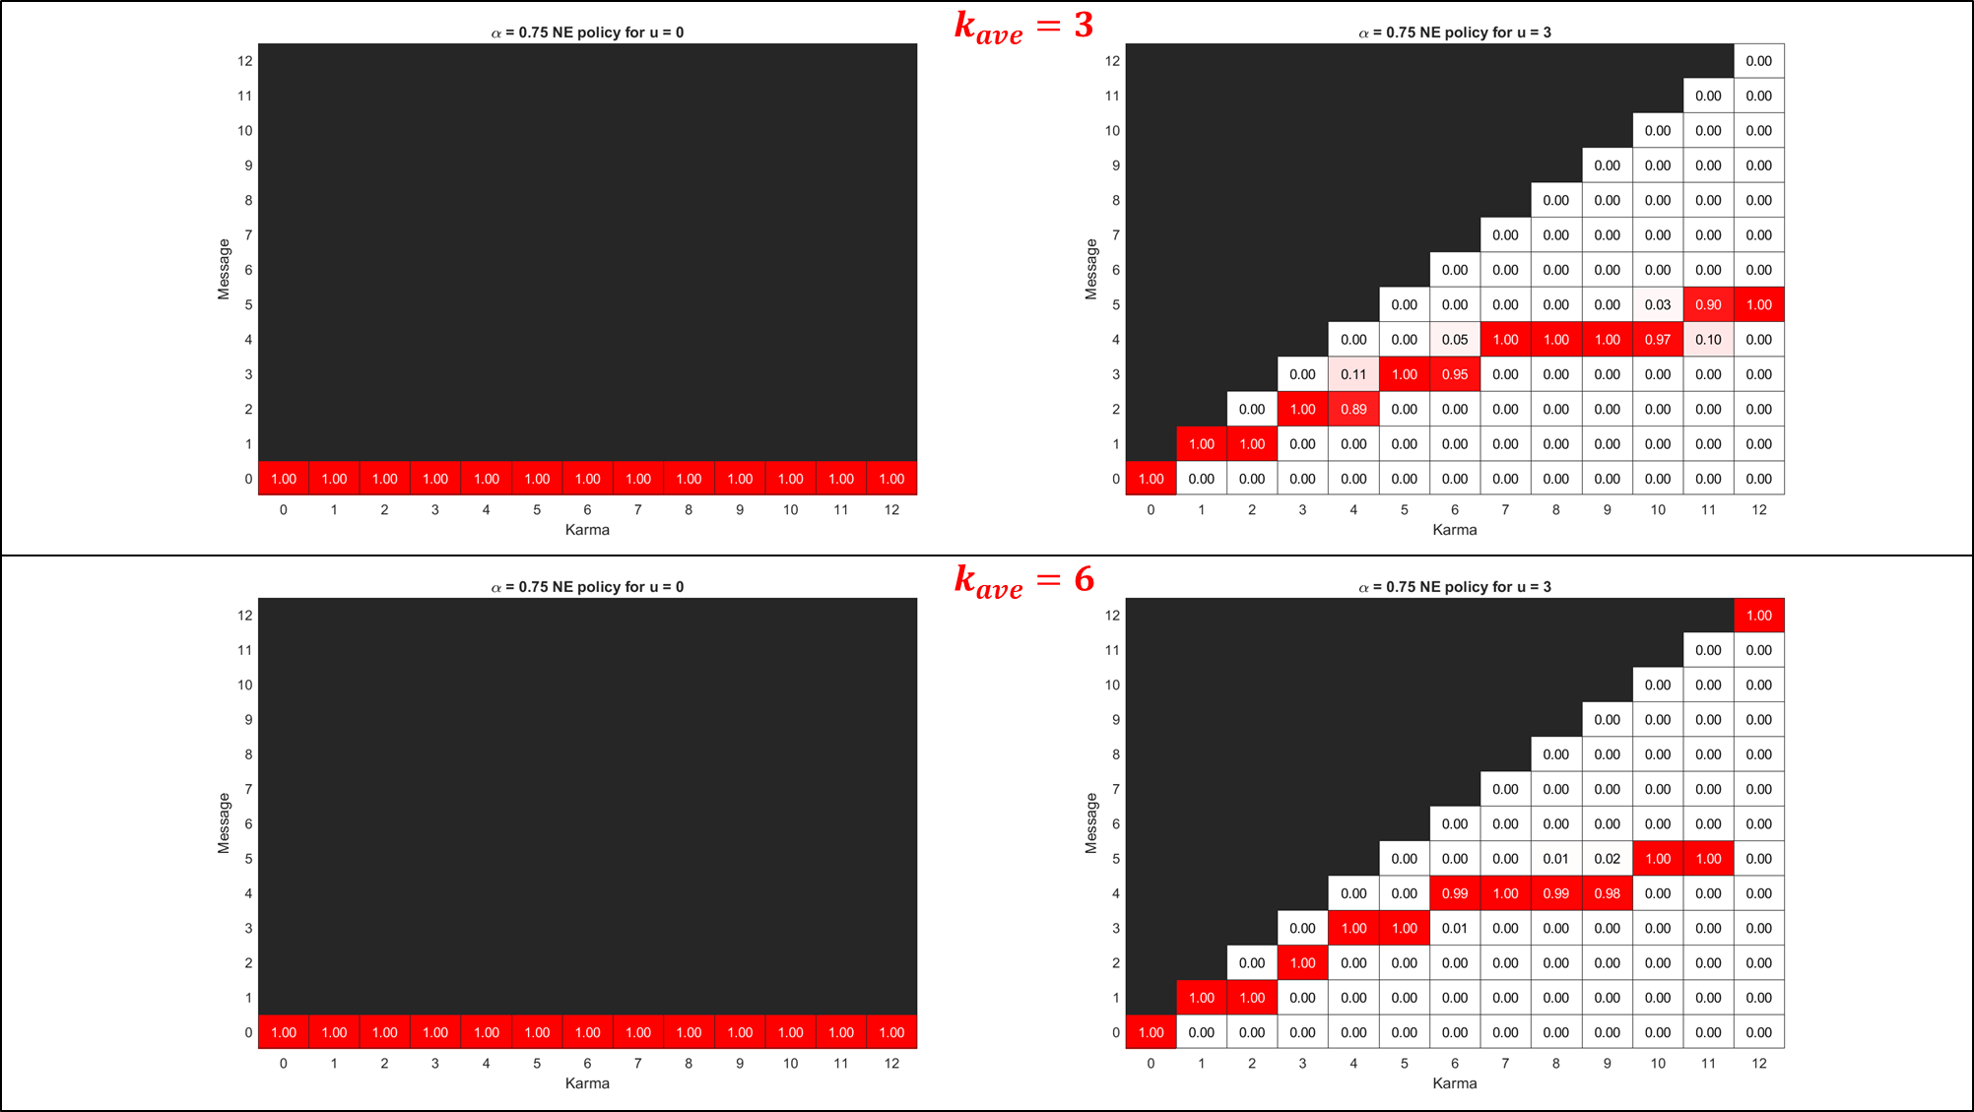

Slide 62
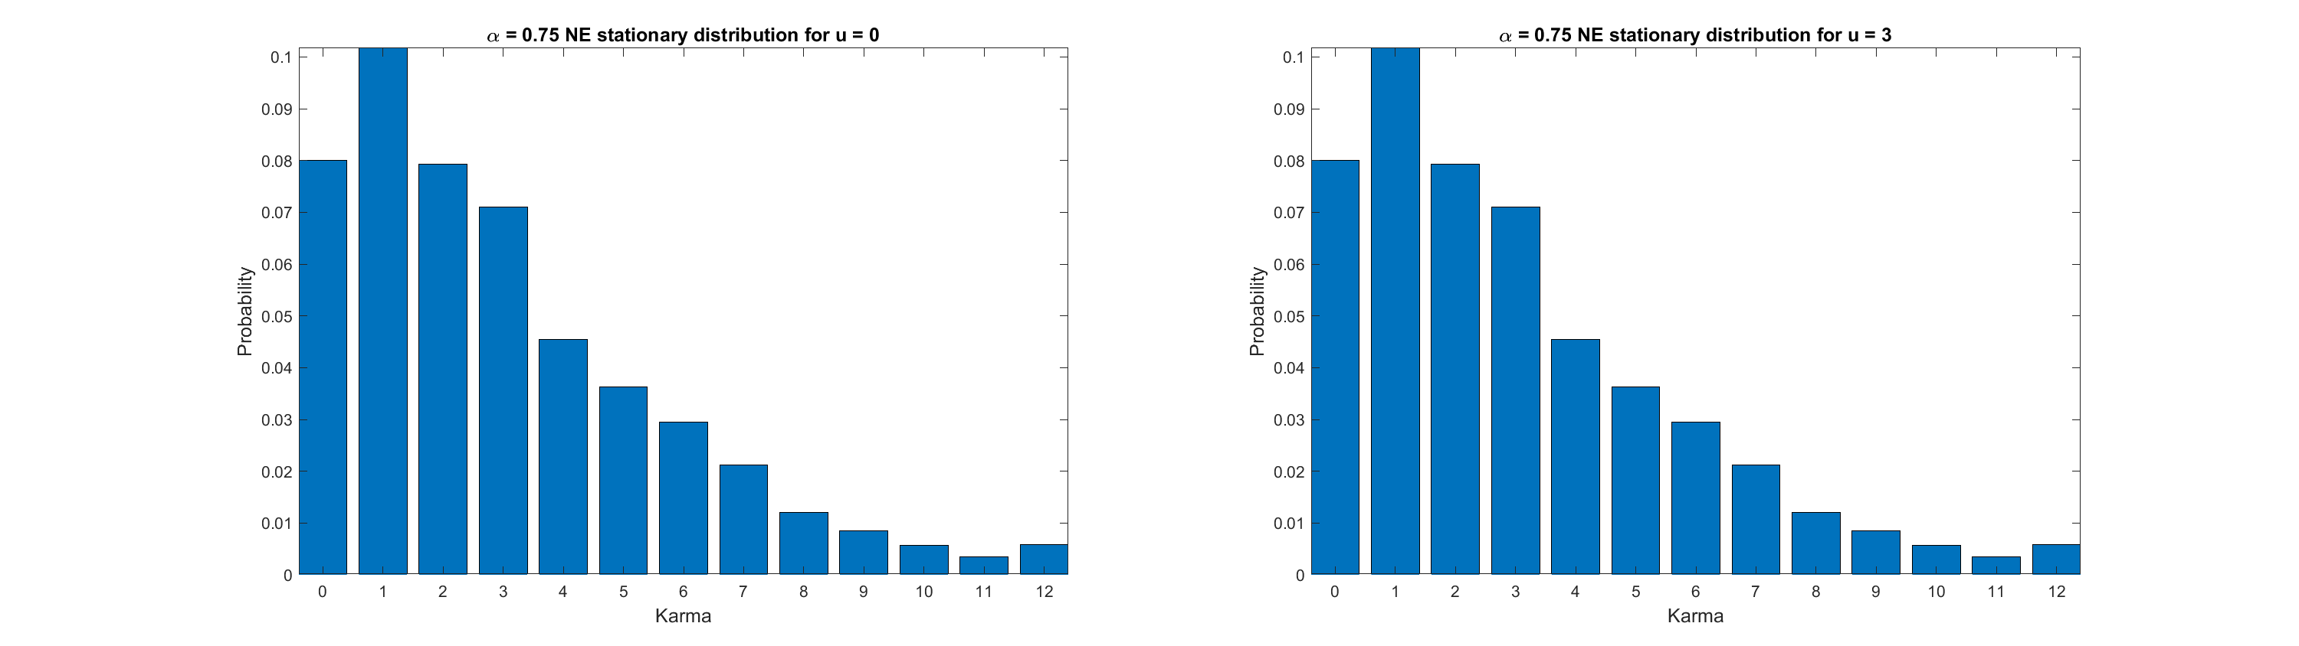
$$k_{ave}=3$$
Notes:
Top: k_ave = 3, k_max = 12
Bottom: k_ave = 6, k_max = 12

Slide 63


Slide 64


$$k_{ave}=6$$
Notes:
k_ave = 6, k_max = 12

Slide 65


Slide 66


$$k_{ave}=6$$
$$k_{max}=12$$
$$k_{ave}=6$$
$$k_{max}=42$$
Notes:
Top: k_ave = 6, k_max = 42
Bottom: k_ave = 6, k_max = 12

Slide 67


Slide 68


$$k_{ave}=6$$
$$k_{max}=42$$
Notes:
Top: k_ave = 6, k_max = 42
Bottom: k_ave = 6, k_max = 12

Slide 69


Slide 70

$$k_{ave}=6$$
Notes:
k_ave = 6, k_max = 12

Slide 71


Slide 72

$$k_{ave}=6$$
Notes:
k_ave = 6, k_max = 12

Slide 73


Slide 74


$$k_{ave}=6$$
$$k_{max}=12$$
$$k_{ave}=6$$
$$k_{max}=24$$
$$k_{ave}=6$$
$$k_{max}=42$$
Notes:
Top: k_ave = 6, k_max = 24
Bottom: k_ave = 6, k_max = 12

Slide 75


Slide 76



$$k_{ave}=6$$
$$k_{max}=12$$
$$k_{ave}=6$$
$$k_{max}=24$$
$$k_{ave}=6$$
$$k_{max}=42$$
Notes:
Top: k_ave = 6, k_max = 24
Bottom: k_ave = 6, k_max = 12

Slide 77


